Slide 1
AMIC – Legacy Data Modernization & Conversion
Prasad Kini
ATCI X-Market Lead
Insurance Platforms

Slide 2
Insurance : Transformation Journey
Accenture Insurance Platforms Practice is integral part of Transformation journey of implementing COTS Platforms and Journey to Cloud
Data Conversion is key to this Transformation Journey which should be fueled by Accelerators and Deep Functional Expertise
Primary scope of Data Conversion services is highlighted
Program Direction
Business & Functional Coordination
(Scope Management, Functional Support, Data Conversions, Data Cleansing, User Acceptance Tests)
Journey to Cloud
Transformation Approach
Product Rationalization assessment
Platforms Implementation Strategy
Conversion strategy for historical data
Phasing of Conversion
Quality &risk mitigation
Configuration Management (Releases, Environments)
Roll-out
Target System Extension and Configuration
System Integration Test
Interface Development
Front Office System Adjustments
User Acceptance Test
Business Objectives
Data Conversion
Extract
Transform
Load
Validate
Dress Rehearsals
Data profiling & Cleansing
Business implementation (Training, Communication, Client Support)

Slide 3




Data Conversion – Challenges
Conversion stages
s
Data Acquisition, Profiling & Cleaning
Data Mapping & Transformation
Loading & Reconciliation
Major Challenges
Project Initiation
Fitment of legacy data into new system
Improper Conversion strategy
Lack of governance and communication between teams
Lack of visibility for correct status of Conversion
Difficulty in deciphering names of data elements
Data Quality issues
Exceptional Policies/Broken Policies
Out of compliance policies
Aiming for Perfection from 1st iteration
Complex Mapping requirements
Lack of documentation leading to erroneous mapping
Product rationalization challenges
Differing calculation logic in Target and source
Failure in data load due to outdated scripts
Compromising migrated data testing to meet deadlines
Reconciliation of Financials
Non-availability of system during Conversion event
Ensuring smoother transition for agents and policyholders

Slide 4




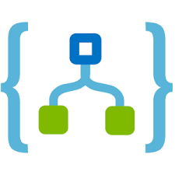



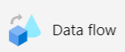

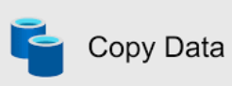
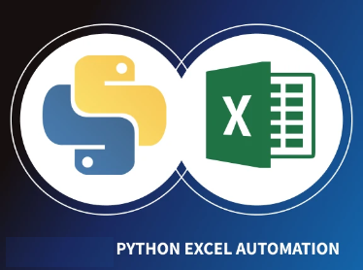



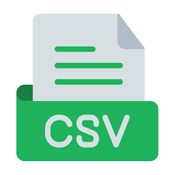





Data conversion for GW – Azure Architecture
MAPPING ANALYSIS
SOURCE
PREP,VALIDATE & TRANSFORM
TARGET
PLATFORM ADMIN
Schema Generation – Source & Target
Data Pipeline Orchestration – Azure Data Factory
Data Profiling
Metadata Ingestion Framework
Pipeline
Orchestration
Metadata Driven mapping
Data Quality
Configuration
Auditing & Error Handling
Reconciliation
Azure Monitor
Schema Profiling
Source DB
Target DB
ER Diagram
Implement data quality rules
Implement transformation tasks
Meta Data Driven
Logic Apps
Lookup Mapping
SQL Server/ RDBMS
7
Assert
DUT Tool
Azure functions
CMTOUT
Security Centre
Excel-Python Automation
1
2
3
4
8
5
CMT Batch
6
Mapping /Build Status Reports
Raw Data
Validated Data
Transformed Data
Storage
Alerts
CMT IN
GW-CC
Postgress – CMT_IN
Postgress- CMT_OUT
Data Wrangling
Schema/Data Profiling
Azure Data Lake
Azure Data Lake
Azure DevOps
Reporting
Data Quality Reports
Email Notification
Key Vault
Reconciliation reports

Slide 5

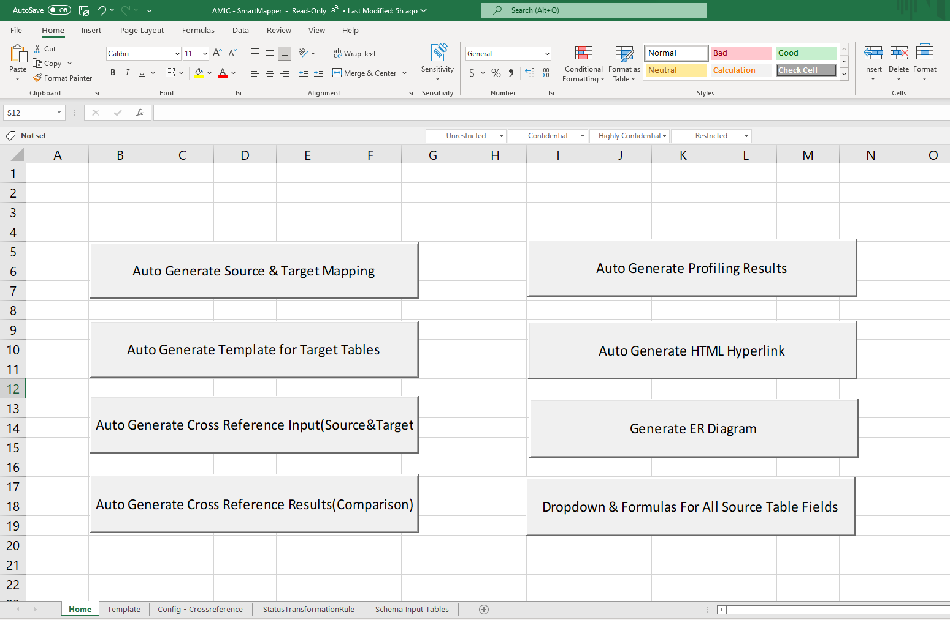
AMIC – Smart Mapper
Auto Generate Source schema & Target schema details (table/column name, data type, length, constraints, mandatory fields)
Auto Generate Data Profiling results (Duplicate rows, DISTINCT values, NULL check, Unique values, Correlation with other fields, Volume, Memory size)
Auto Generate ER diagrams (Key relationships and their columns)
Auto Generate Cross reference tables metadata mapping (Source & Target)
Auto Generate dropdown for mapping status & mandatory fields in mapping
Copyright © 2023 Accenture. All rights reserved.
5

Slide 6
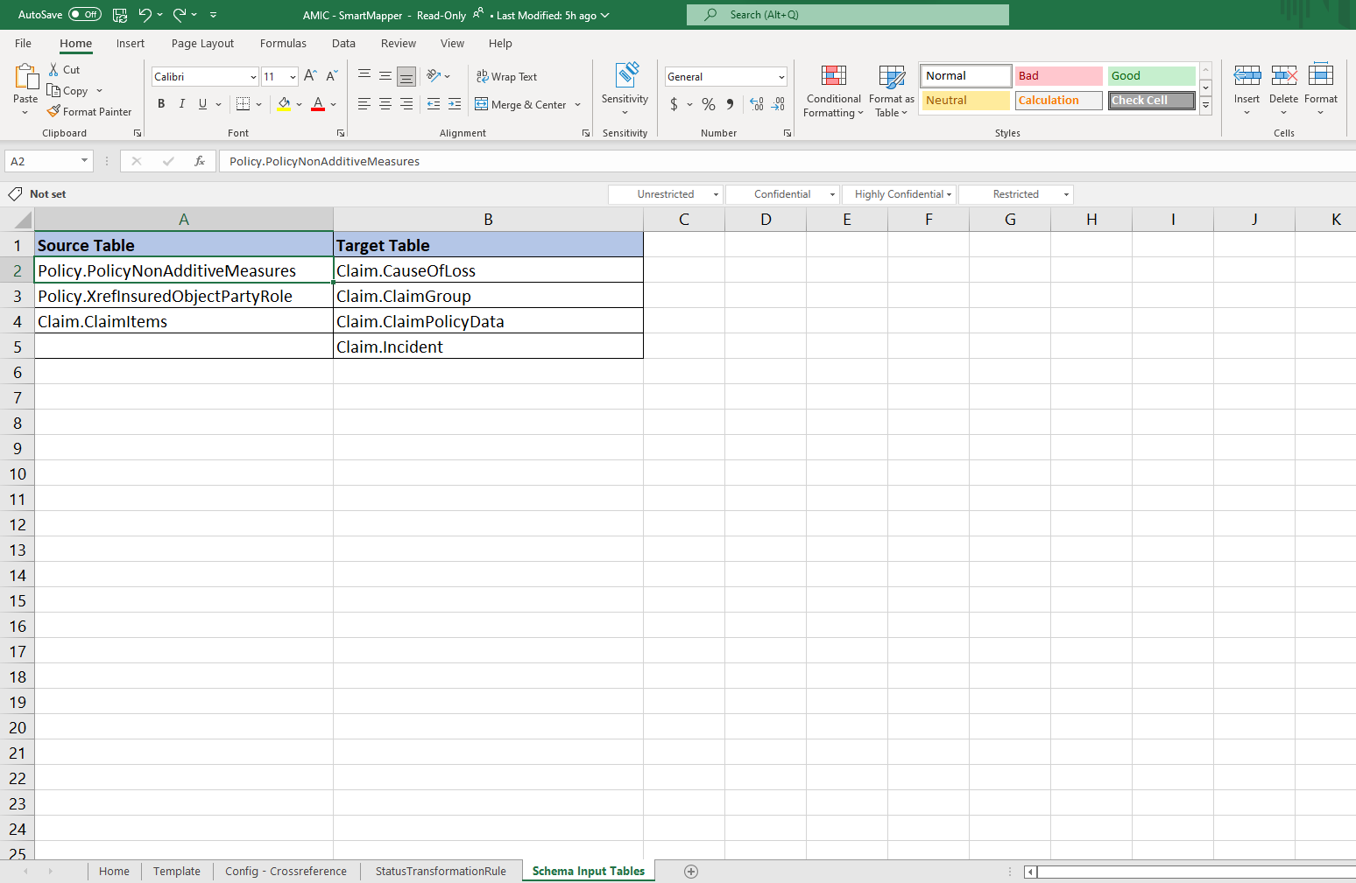
Auto Generate Source & Target Mapping
Auto Generate Source & Target Mapping
Configuration

Slide 7
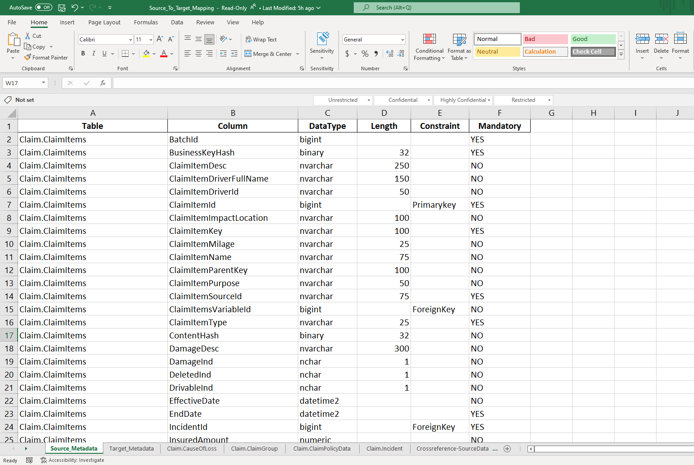
Auto Generate Source & Target Mapping
Auto Generate Source & Target Mapping
Output

Slide 8
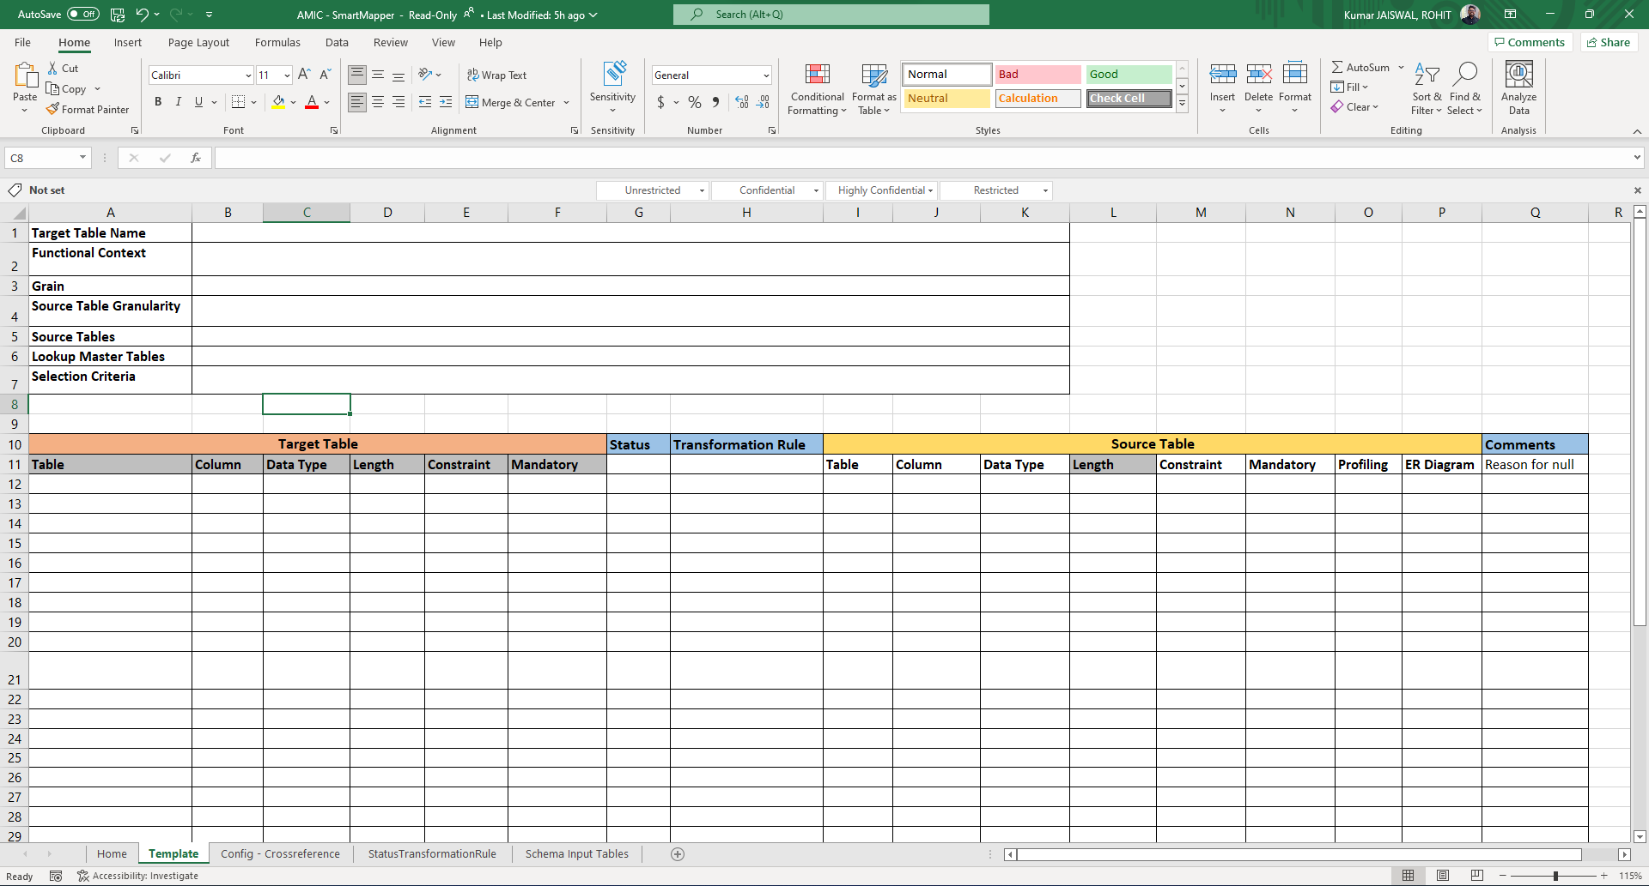
Auto Generate Template For Target Tables
Auto Generate Template For Target Table
Configuration

Slide 9
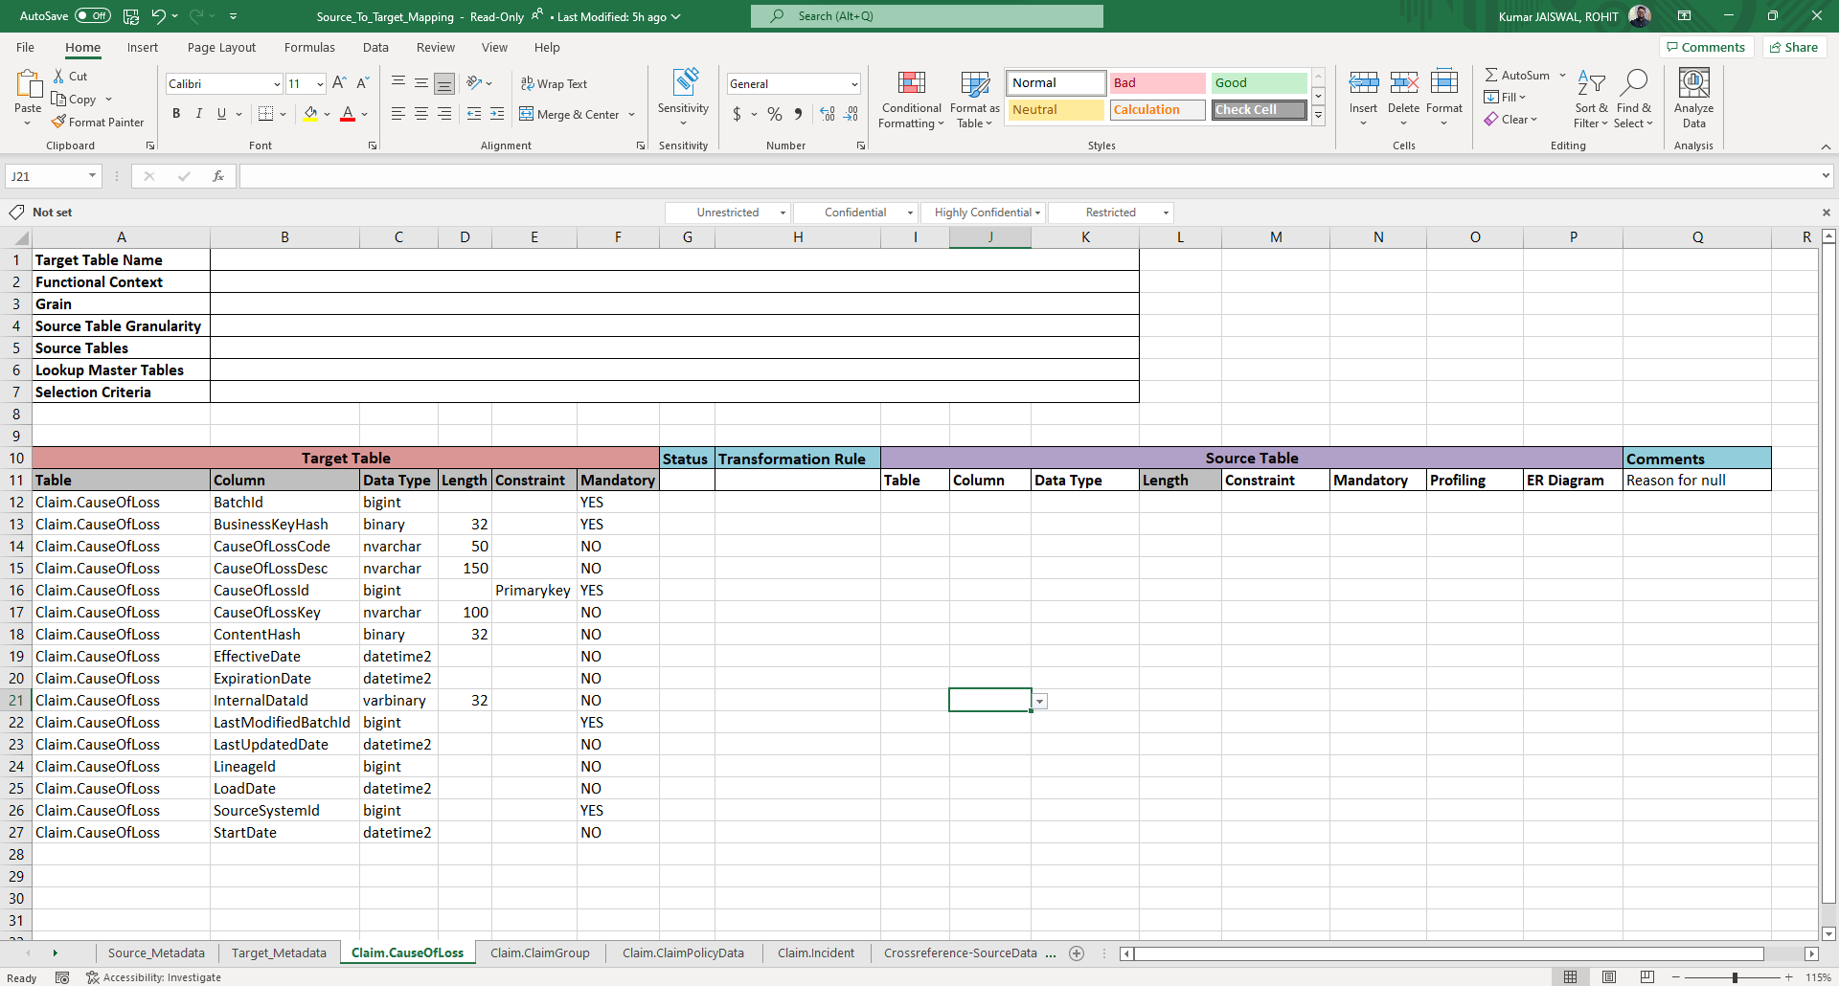
Auto Generate Template For Target Tables
Auto Generate Template For Target Table
Output

Slide 10
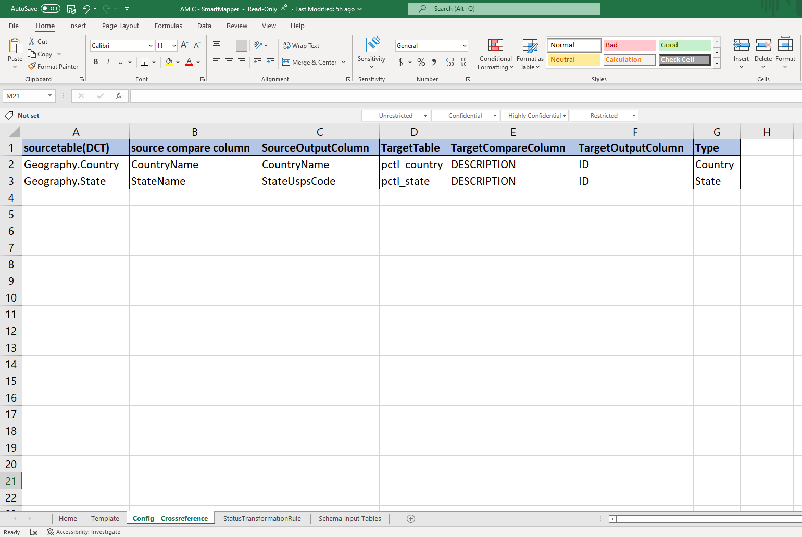
Auto Generate Cross Reference Input
Auto Generate Cross Reference Input (Source & Target)
Configuration

Slide 11
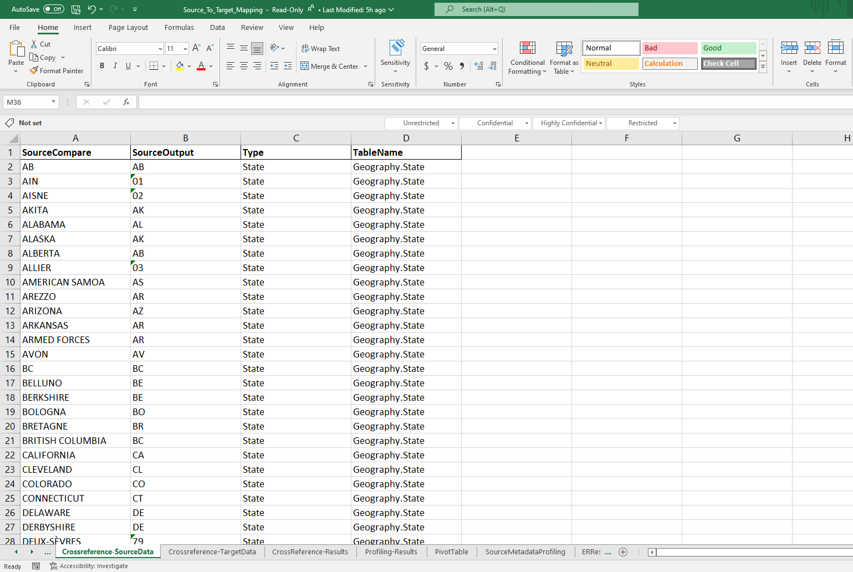
Auto Generate Cross Reference Input
Auto Generate Cross Reference Input (Source & Target)
Output(1)

Slide 12
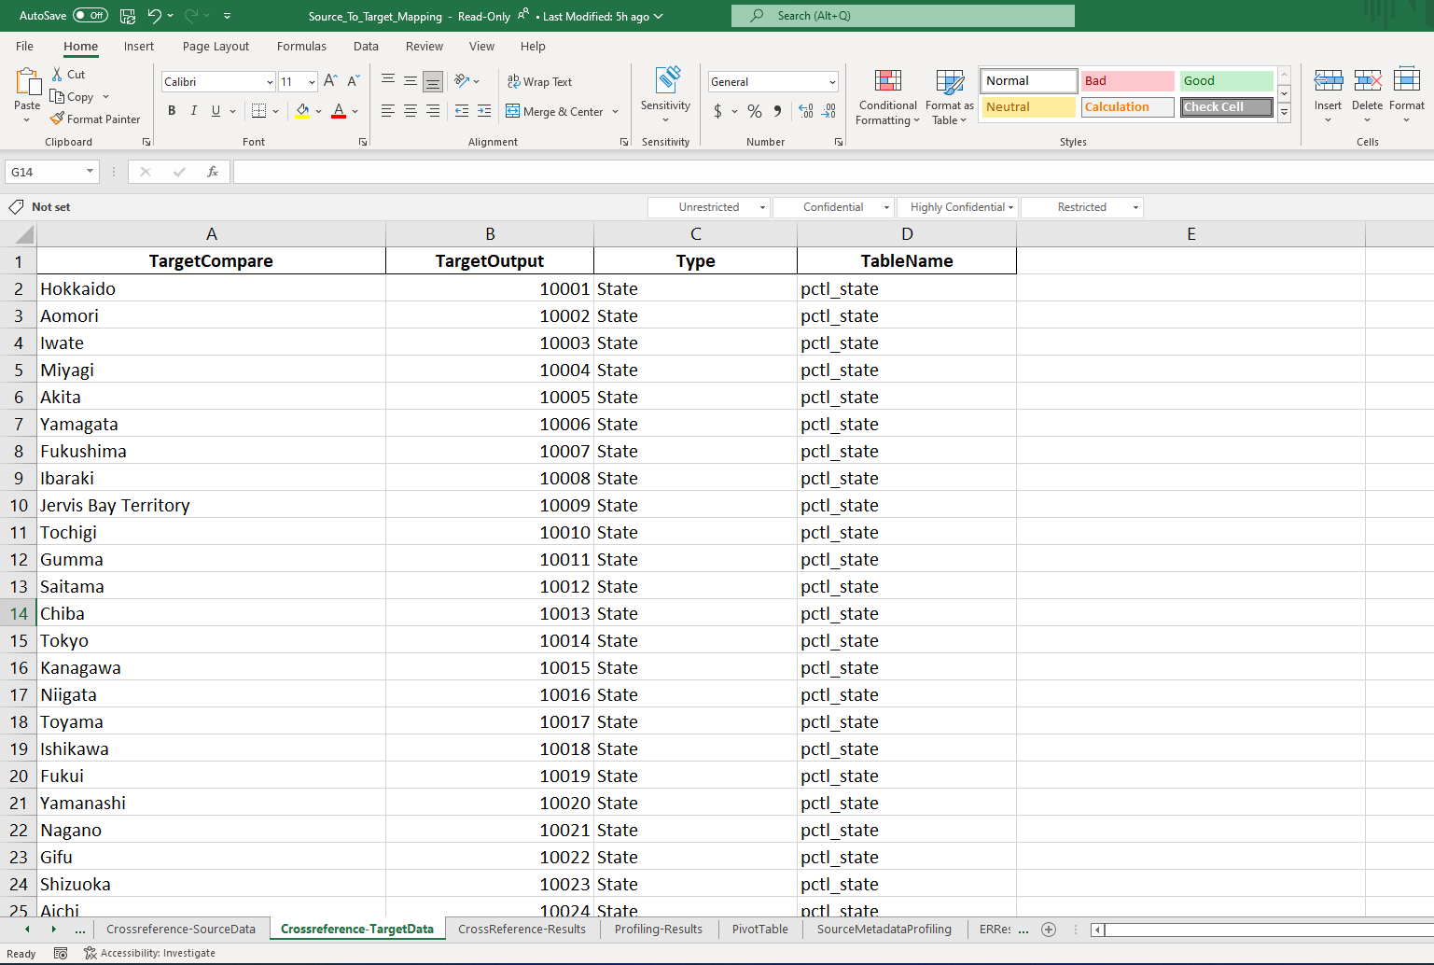
Auto Generate Cross Reference Input
Auto Generate Cross Reference Input (Source & Target)
Output(2)

Slide 13
Auto Generate Cross Reference Results
Auto Generate Cross Reference Results (Comparison)
Configuration

Slide 14
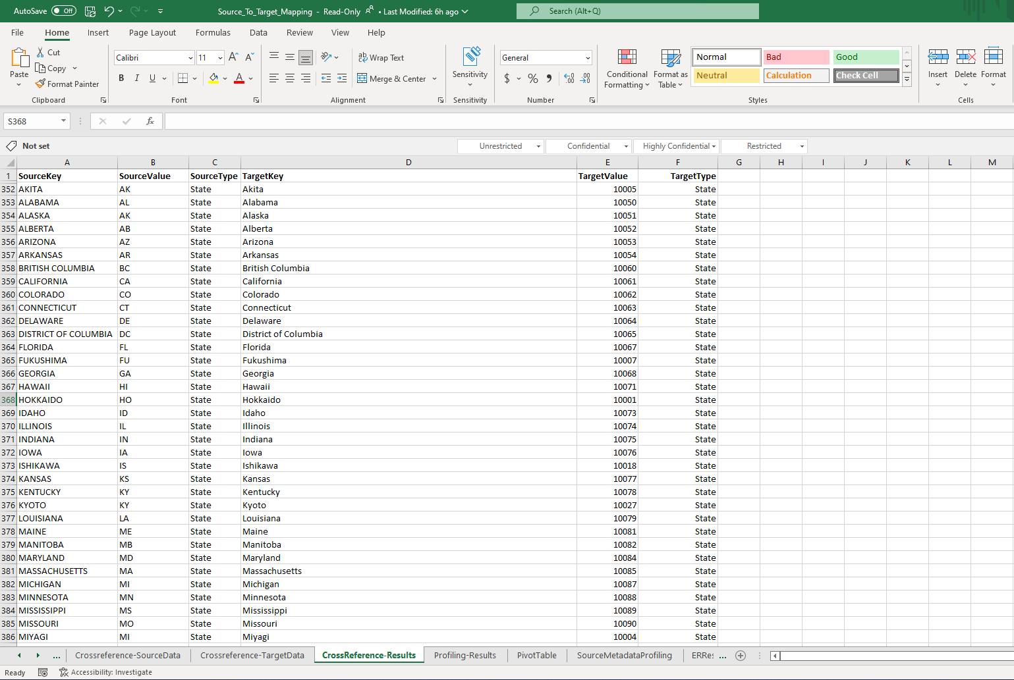
Auto Generate Cross Reference Results
Auto Generate Cross Reference Results (Comparison)
Output

Slide 15
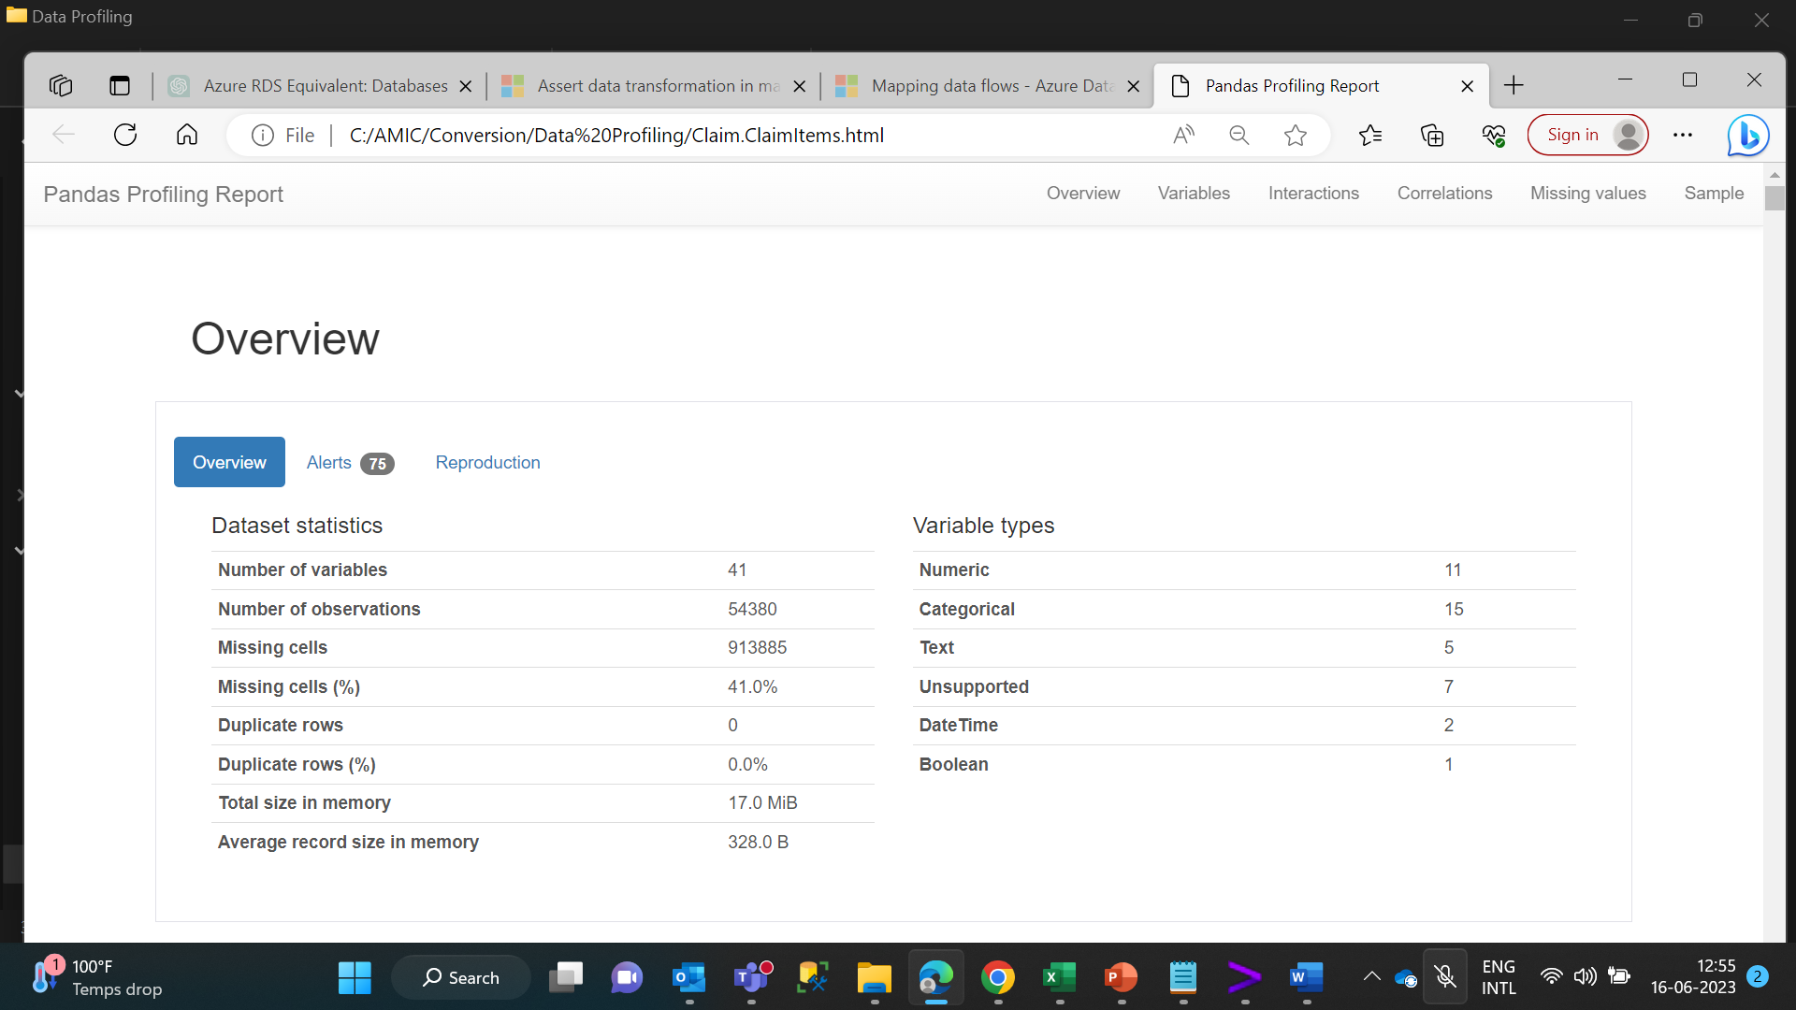
Auto Generate Profiling Results (Overview)
Auto Generate Profiling Results

Slide 16
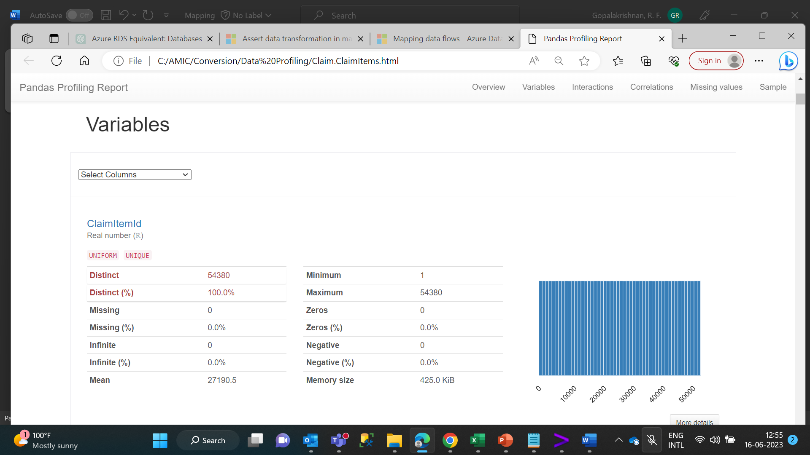
Auto Generate Profiling Results (Variables)
Auto Generate Profiling Results

Slide 17
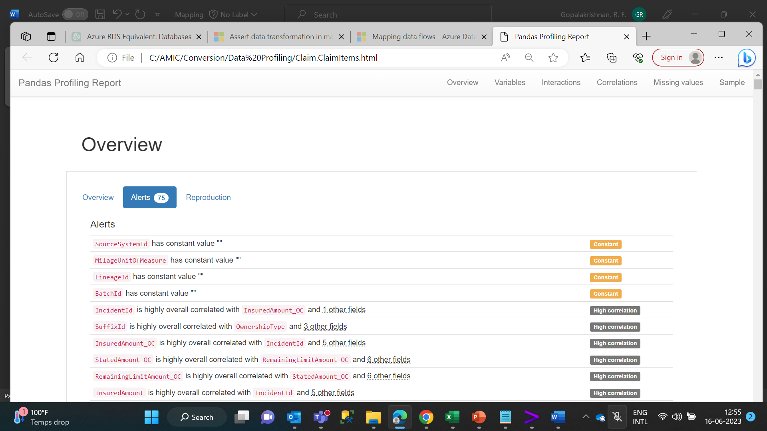
Auto Generate Profiling Results (Overview-Alerts)
Auto Generate Profiling Results

Slide 18
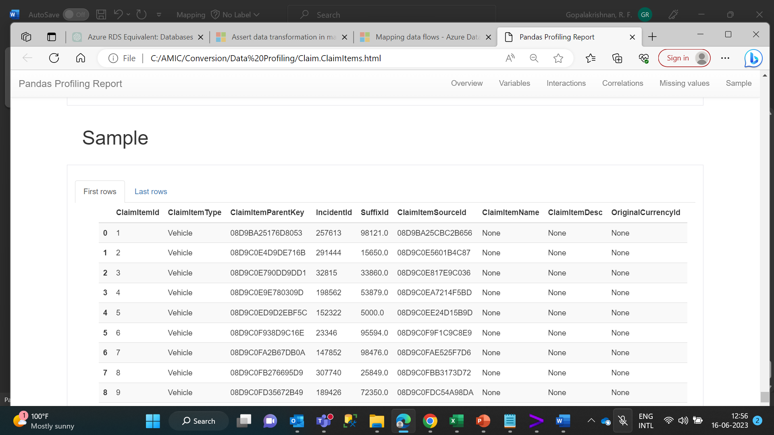
Auto Generate Profiling Results (Sample)
Auto Generate Profiling Results

Slide 19
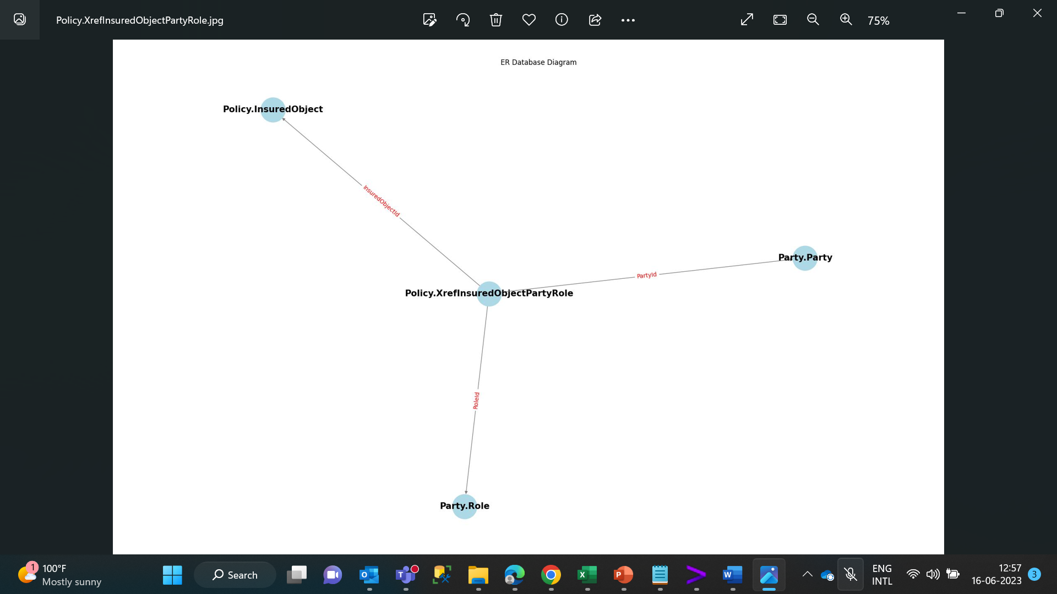
Generate ER Diagram
Generate ER Diagram

Slide 20
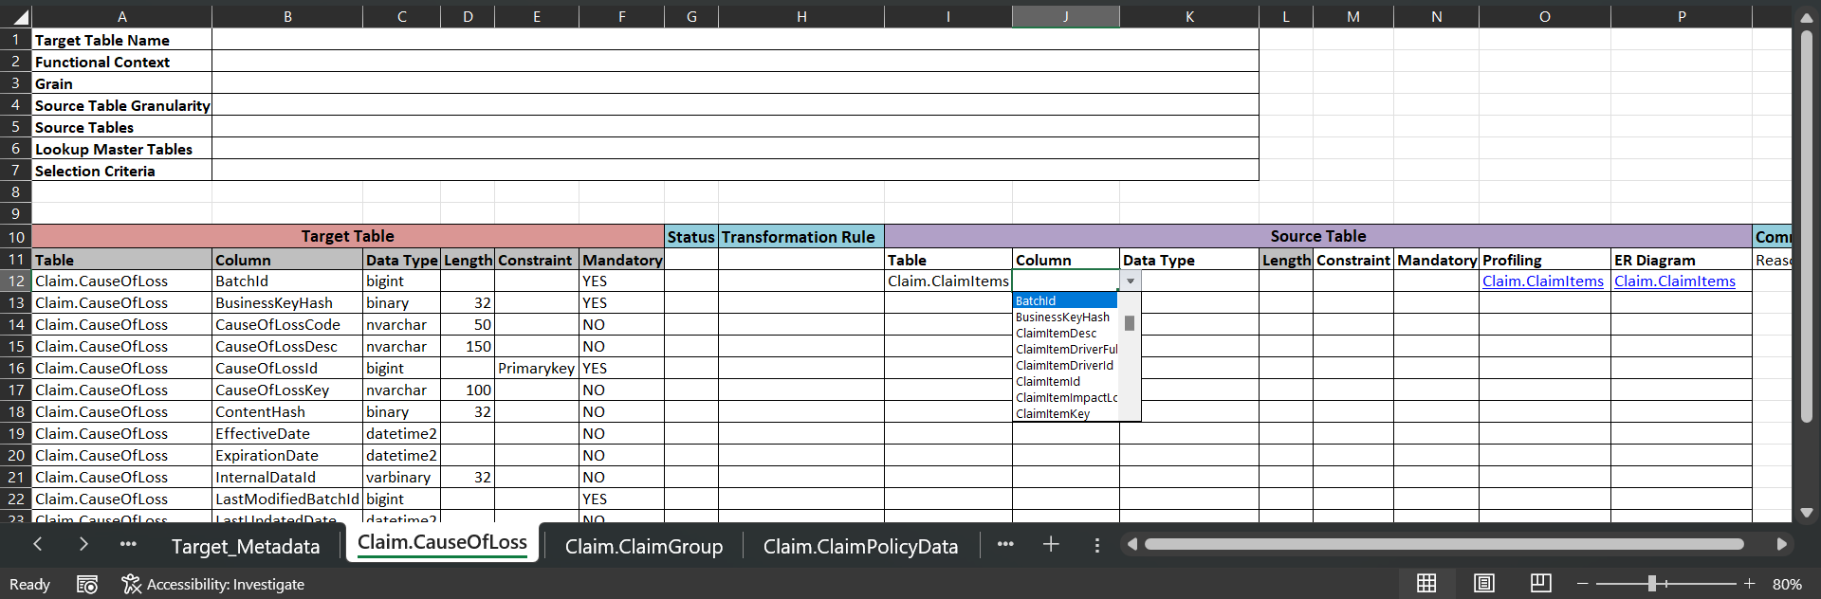
Auto Generate HTML hyperlink
Auto Generate HTML Hyperlink

Slide 21
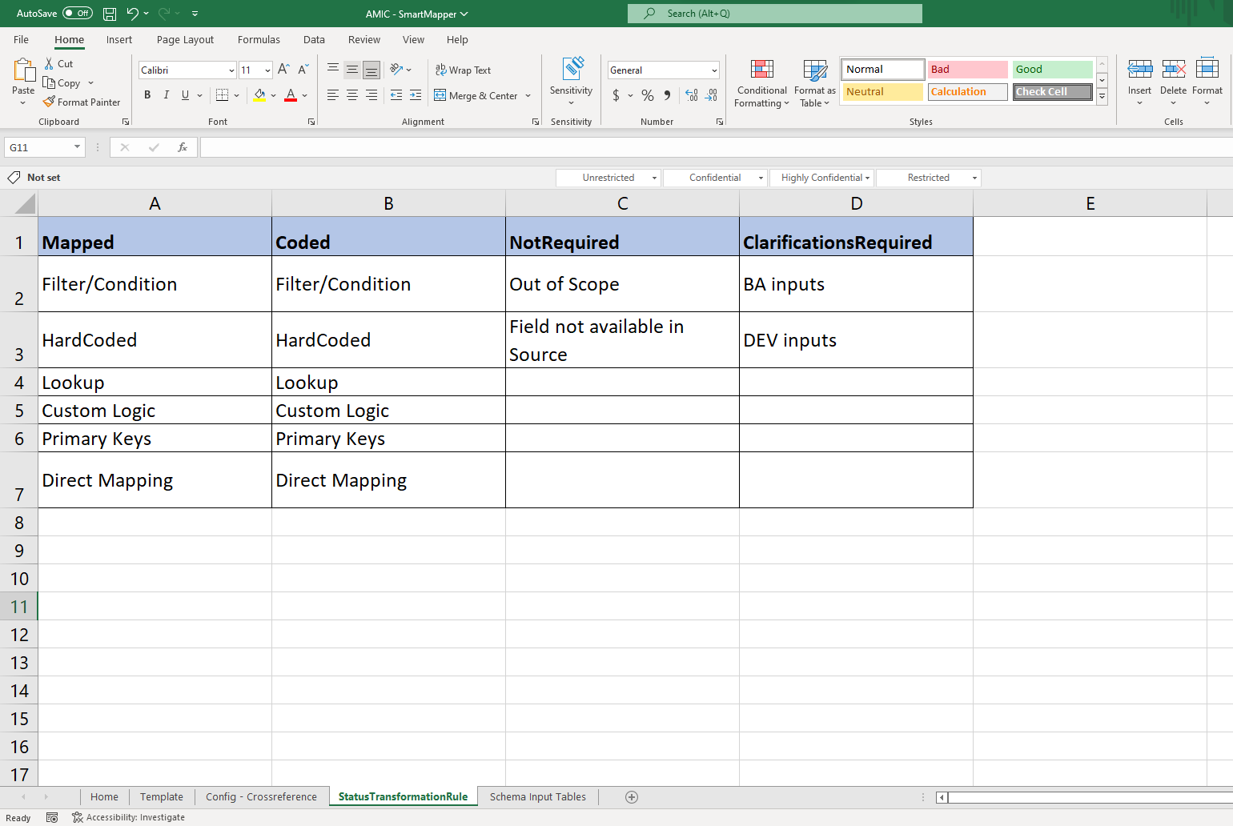
Dropdown & Formulas for All Source Table Fields
Dropdown & Formulas For All Source Table Fields
Configuration

Slide 22
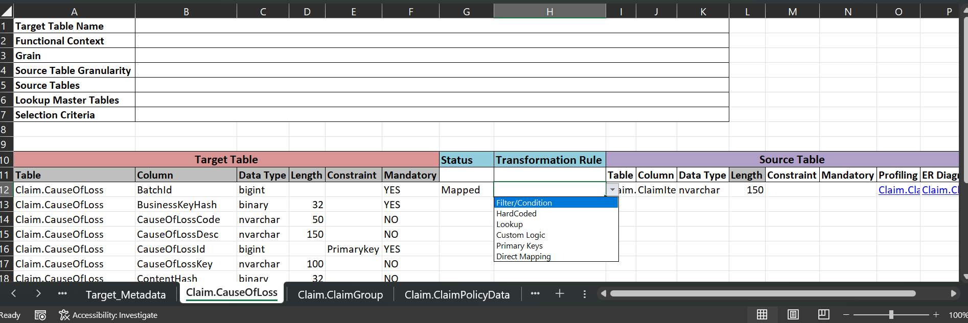
Dropdown & Formulas for All Source Table Fields
Dropdown & Formulas For All Source Table Fields
Output

Slide 23
Mapping/Conversion Status Tracker (1/2)

Slide 24
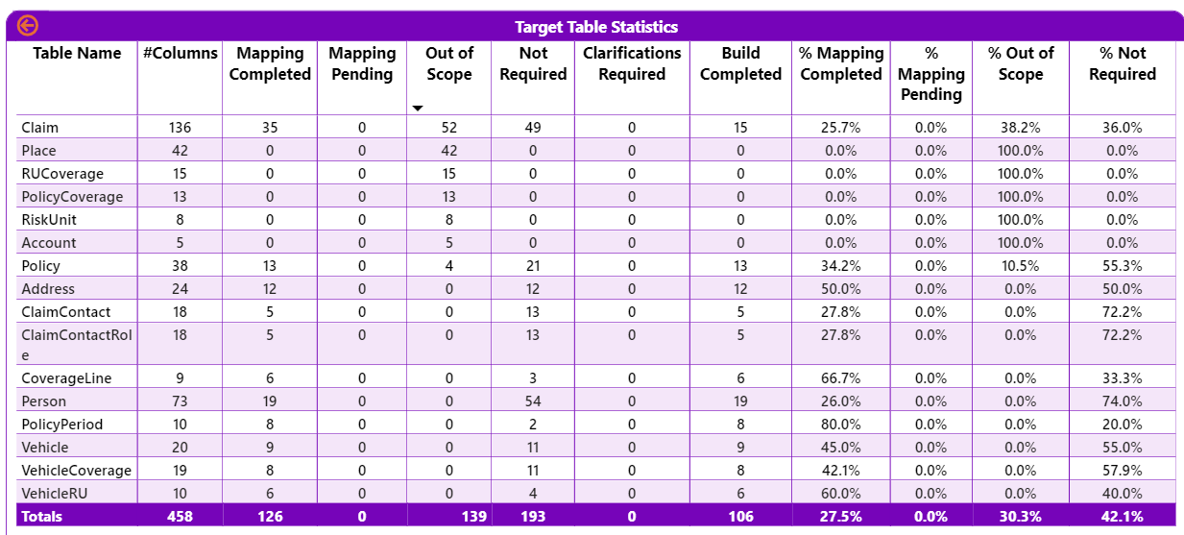
Mapping/Conversion Status Tracker (2/2)

Slide 25
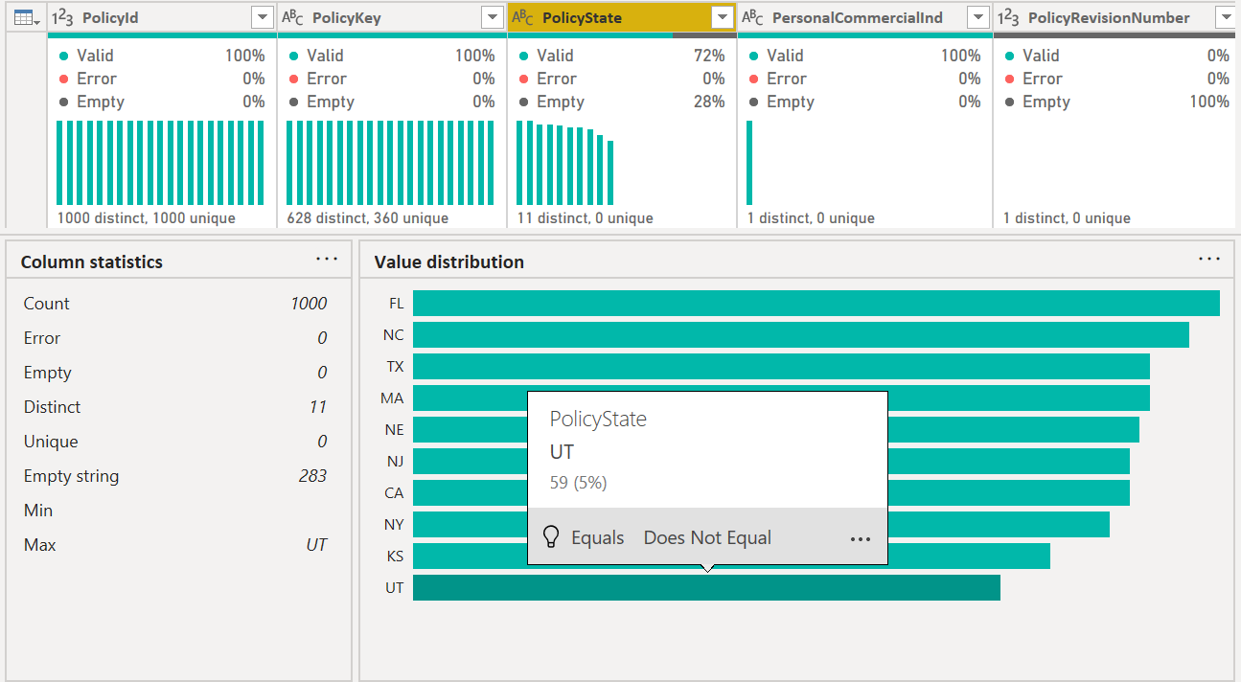
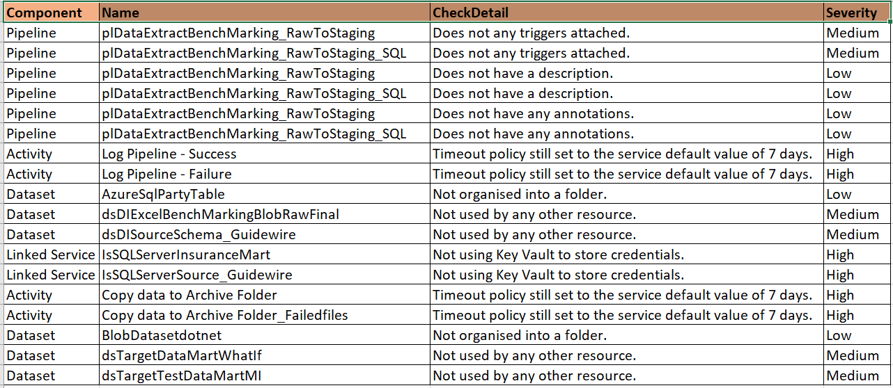
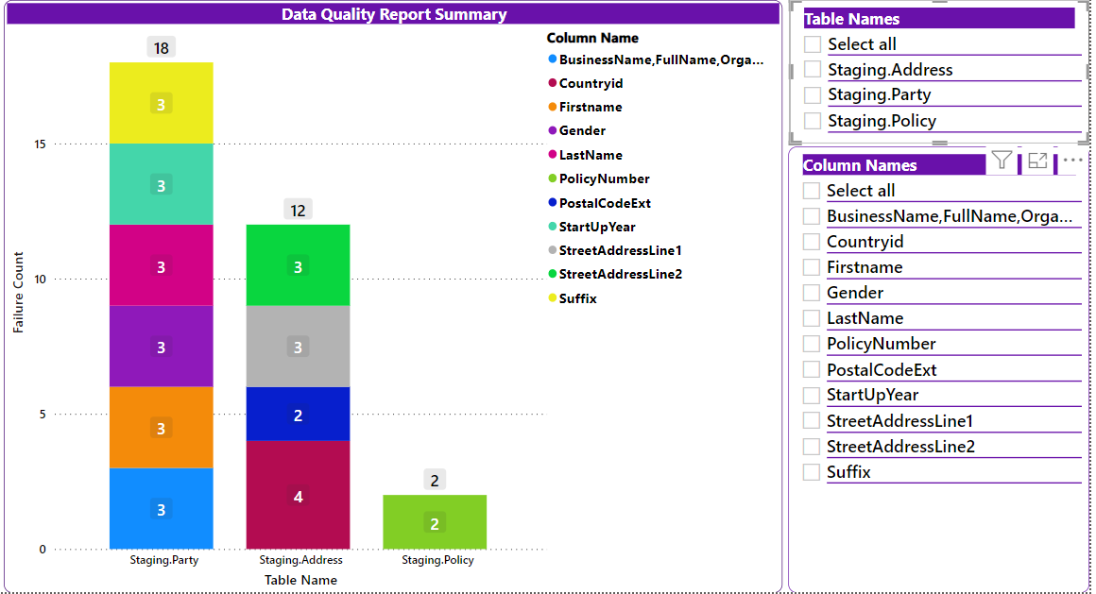
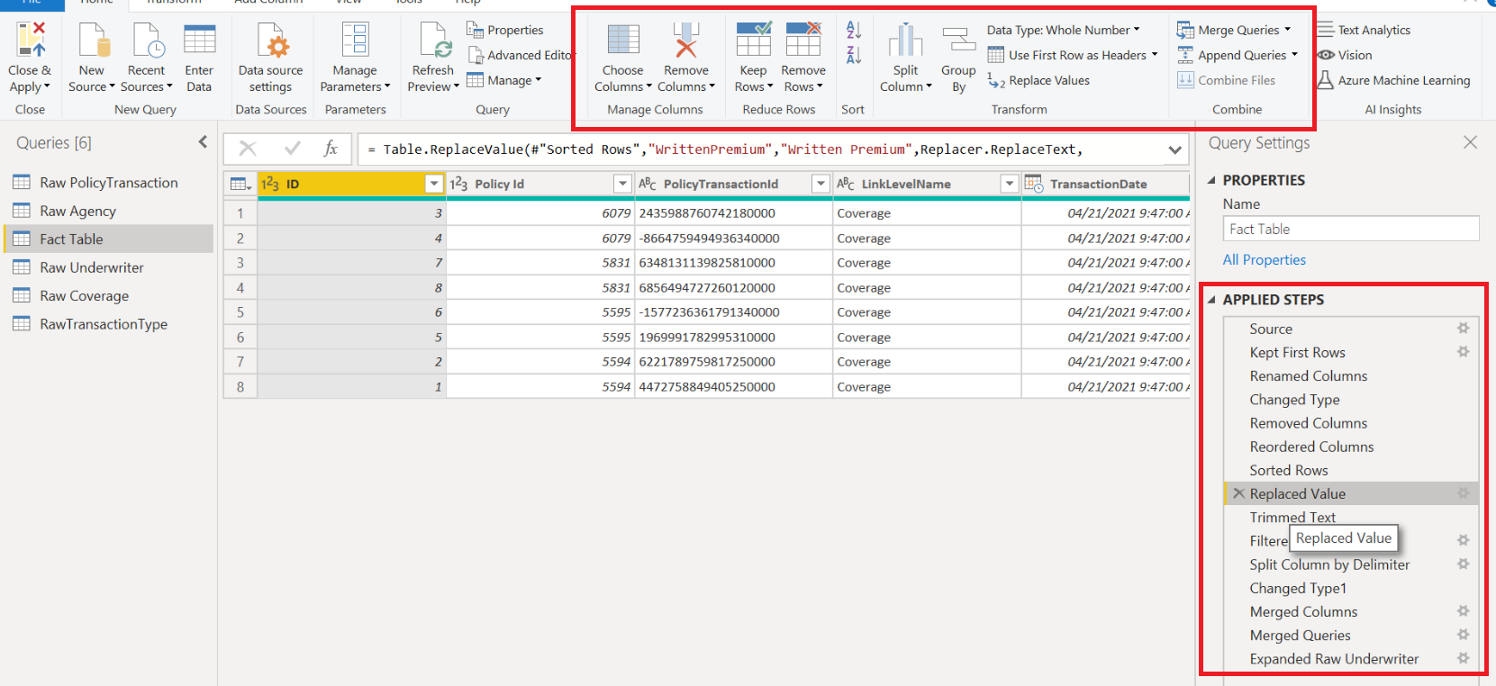
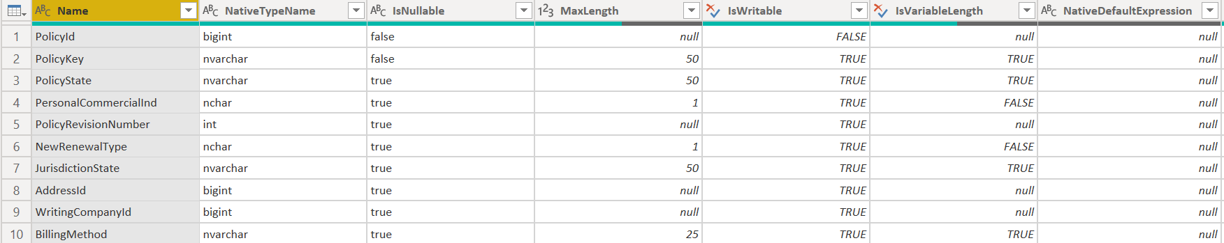
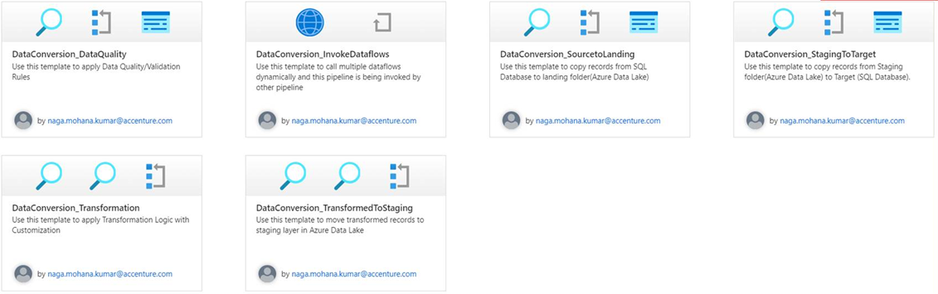
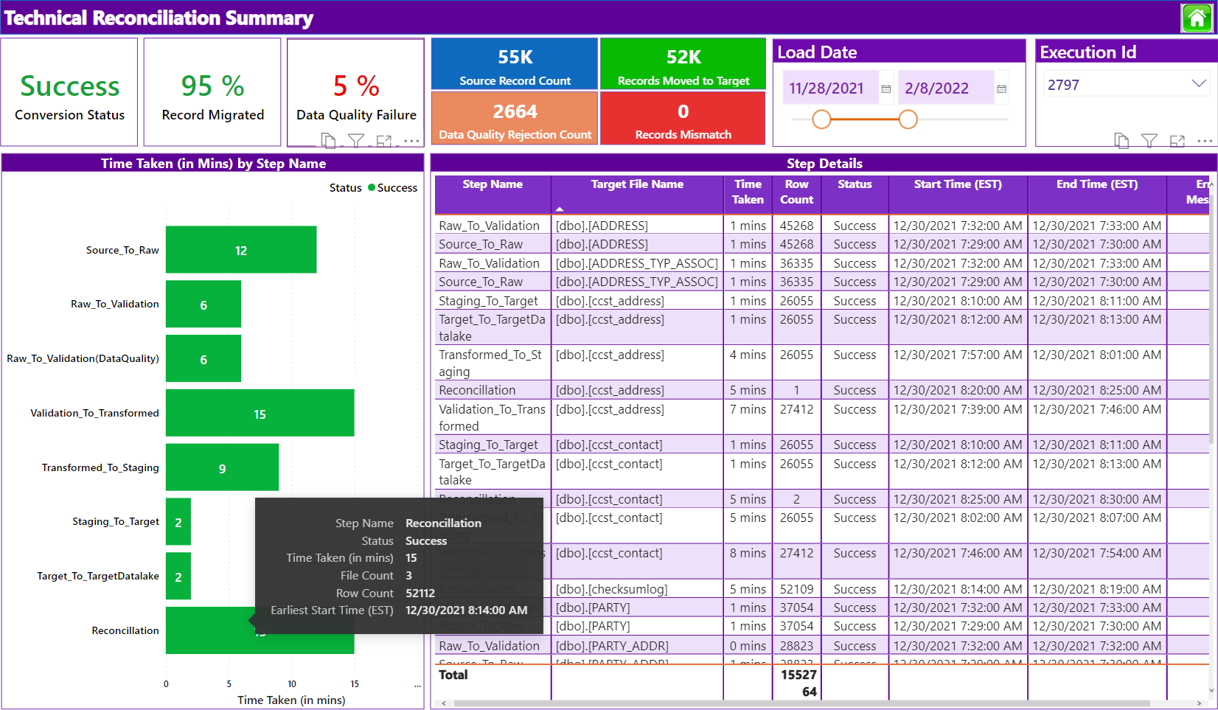
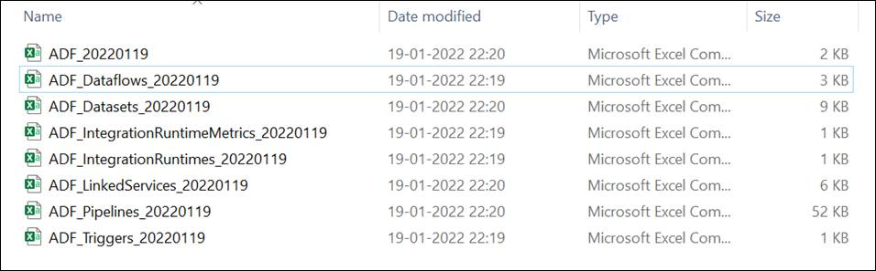
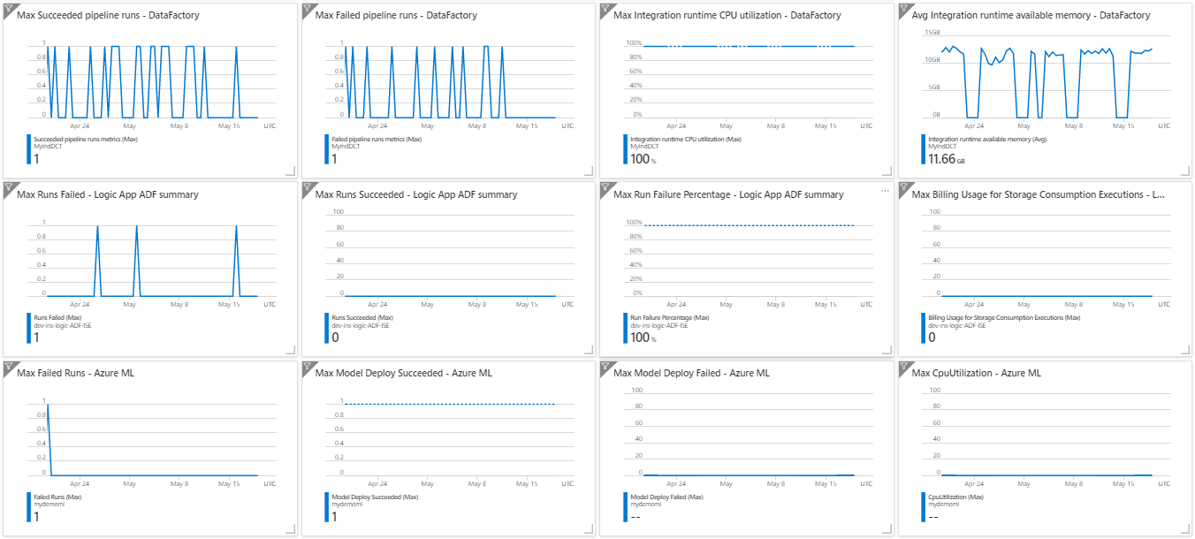
ADF – Accelerators To Optimize Quality & Increase Delivery Speed
Data & Schema Profiling
Code Quality Checker
Data Cleansing
Data Wrangling
Power BI - Provide intuitive ways to clean, transform, and understand data such as key statistics and distributions in Power Query Editor.
Scans all ADF objects and generates Code Quality results in excel sheet. This makes sure that all team members are enforcing the naming conventions and best practices.
Reports generated on top of records where Data Quality rules failed. Both summary & detailed view available
Power BI - Involves piecing raw data together and understanding the business context of data like merging multiple data sources into a single dataset for analysis.
Re-usable Templates
Technical Reconciliation Report
Automatic Documentation
Continuous Monitoring
Different organizations have similar data integration needs and require repeat business processes.
Improve developer productivity along with reducing development time for repeat processes.
Reconciliation reports with all auditing and error details available which includes % of Data Quality failure,% of records migrated successfully, error messages in case of any failures
Automation scripts will scan all ADF objects and generates them in excel format where we can use this as technical design document instead of manually preparing one and updating for each iteration/development changes.
Azure Monitor helps you maximize the availability and performance of your applications and services.
This information helps you understand how your applications are performing and proactively identify issues affecting them and the resources they depend on

Slide 26
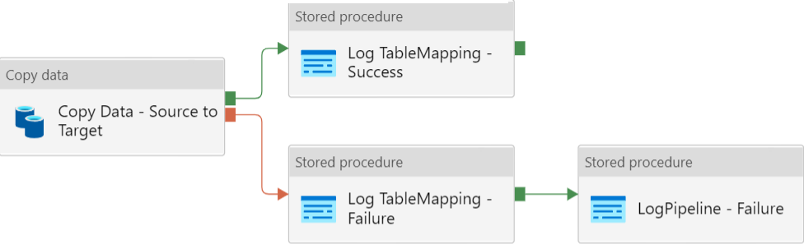
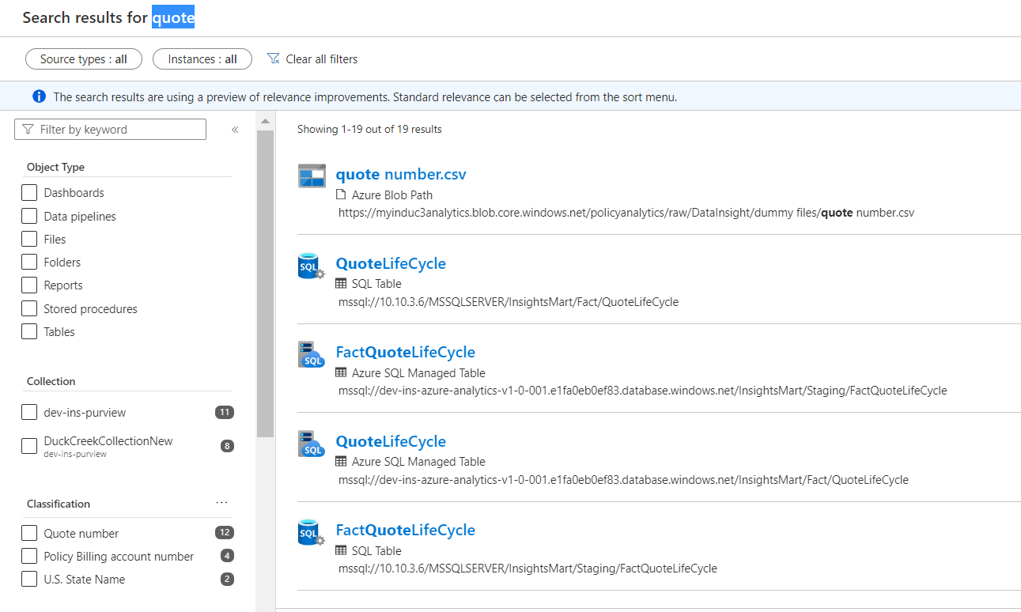
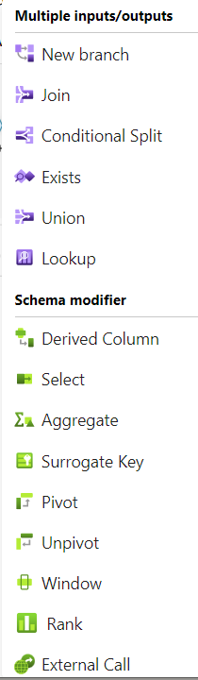
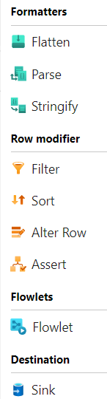
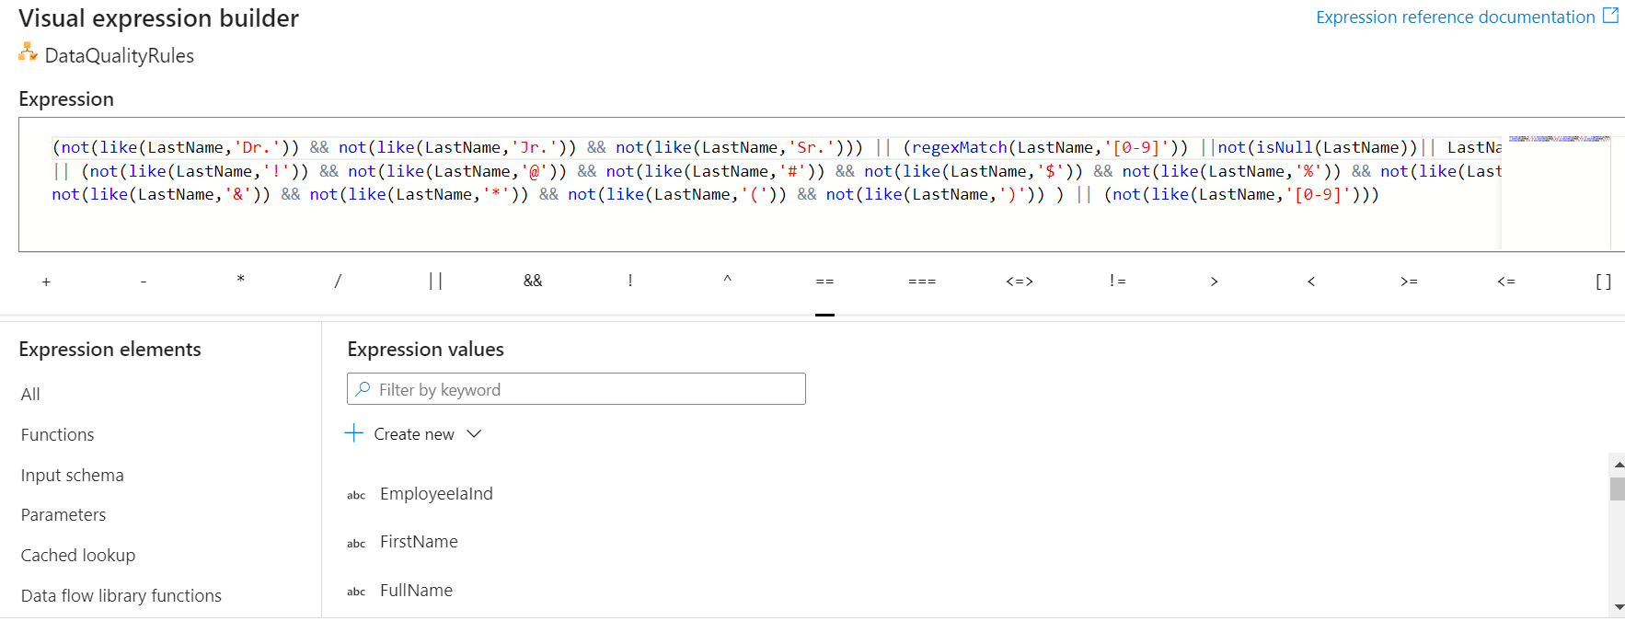
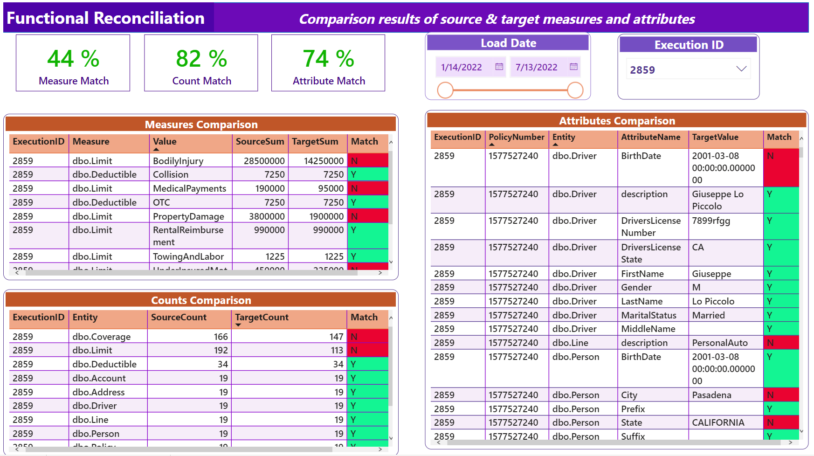
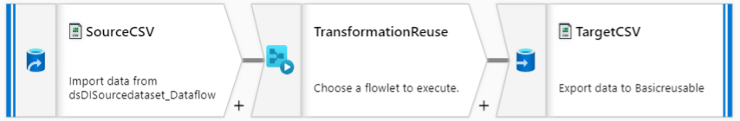
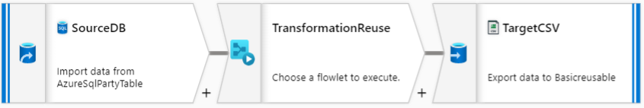
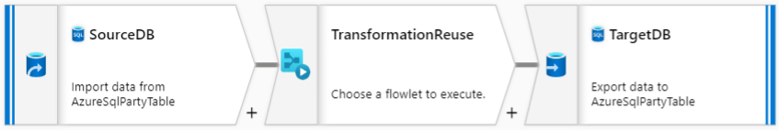
ADF – Accelerators To Optimize Quality & Increase Delivery Speed
Copy Data – Configuration Driven
Data Discovery & Classification – Multiple Sources
No Code Transformation in ADF
Enable Business Analyst/Data engineers to access trustworthy data from multiple sources and benefit from the automated classification by Purview
Using this framework, data/files can be copied from source server to target server with no code. Only metadata configuration is required
No code Data Quality Rules in ADF
Functional Reconciliation Report
Visual build your Data Quality Rules using Assert transformation in ADF. This will help to determine if each row/column value in your data meets a set of criteria. It also allows you to set custom error messages when data validation rules are not met
Reusable ETL logic
Create reusable portions of data flow logic that you can share in other pipelines as inline transformations. Flowlets enable ETL jobs to be composed of custom or common logic components
Below results are generated as part of existing functional reconciliation process:
Simple record counts check for each table to keep track of whether the targeted number of records have migrated or not
Compare SUM of measure fields between source and target
Compare individual transactions between source and target
Mapping Data Flow - Visually designed data transformations which allows data engineers to develop data transformation logic without writing code. The resulting data flows are executed as activities within Azure Data Factory pipelines that use scaled-out Apache Spark clusters.

Slide 27
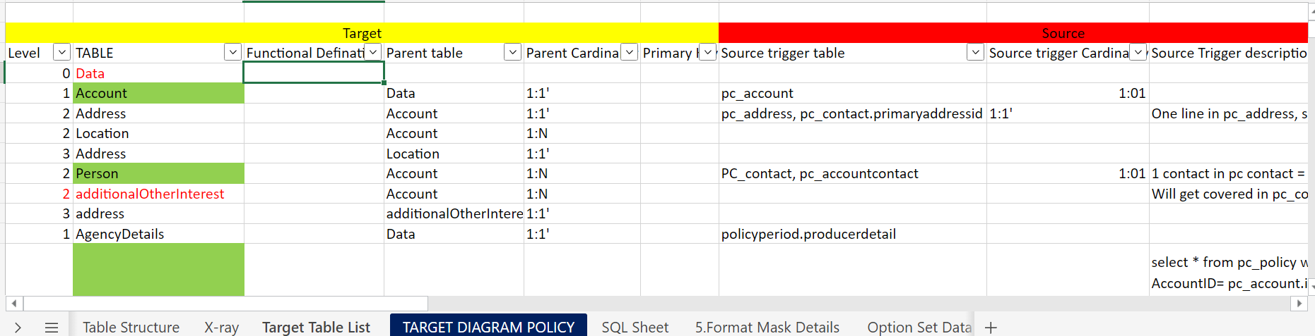
Functional activity before mapping
We maintain a reference sheet that houses every detail that we may need for Conversion project –
Business Decisions
Assumptions
Status
Source ER diagram with joints
Source table list along with functional area, level of the table, parent table mapping, cardinality
Target ER diagram with joints
Target table list along with functional area, level of the table, parent table mapping, cardinality
Process mapping and enriching the source triggers next to target tables with granularity
Target master list
Target field types, values, constraints, format masks, lengths, conditions

Slide 28
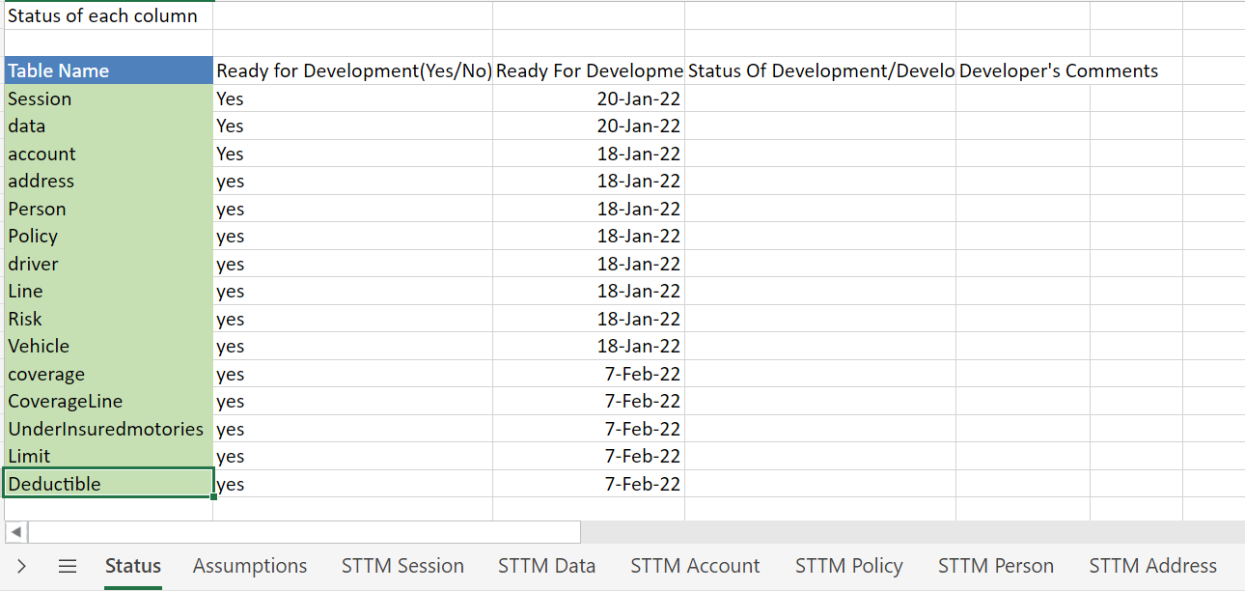
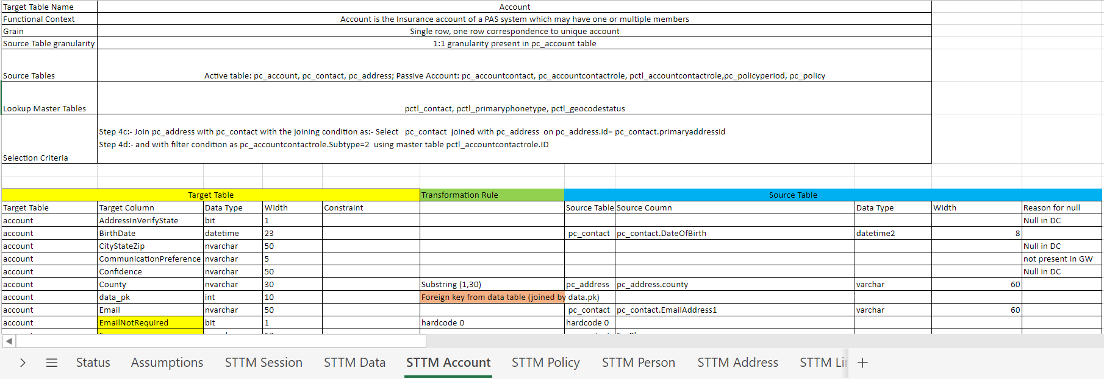
Handling source to target mapping
STTM:- Source to Target Mapping.
The Sheet contains the target tables, columns and its definition.
It contain tabs for Tracking all the tables.
Assumptions can be captured for smooth understanding.
Master Data can be mapped in the “Master Data Lookup” sheet. Master data processing is automated which saves time and efforts.
Clear definition of source tables and how to map between the source tables helps us keep track of source scope coverage.
Business Transformations needs to be mentioned wherever the data can not be mapped directly.
Simulations built in the STTM template helps us build systematic approach in requirement gathering and easy way to show to developers – minimizing the bugs.

Slide 29





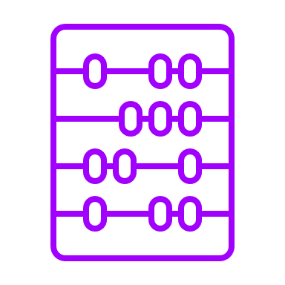
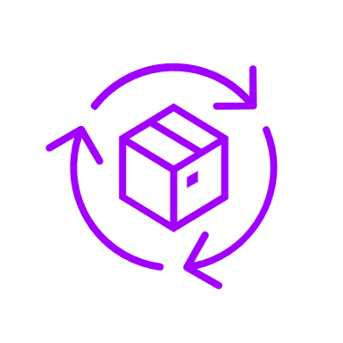






Functional methodology
Customer table discussion
Understanding high level gaps and Create Conversion Sheet by identifying Duckcreek tables.
Xray:- Target system analysis.
Define transformation rules using Xray.
Create STTM Sheet template based on the tables Identified in Target
Duckcreek table discussion with Customer. Using STTM Sheet.
Discussing initial Assumptions
Share STTM Template with Customer for inputs
Create/Review the STTM sheet filled by Customer
Write and finalize
Business rules where data is not matching
Create Query based on the STTM Sheet
Review the Queries with Customer
Share STTM and Queries with Development Team

Slide 30
ADF Data Quality Rules – Configuration driven
Run DQ rules on your source/target data quickly without any code
BA configures the rules in excel and run the DQ pipelines
Rules available for Configuration
Configuration by BA

Slide 31
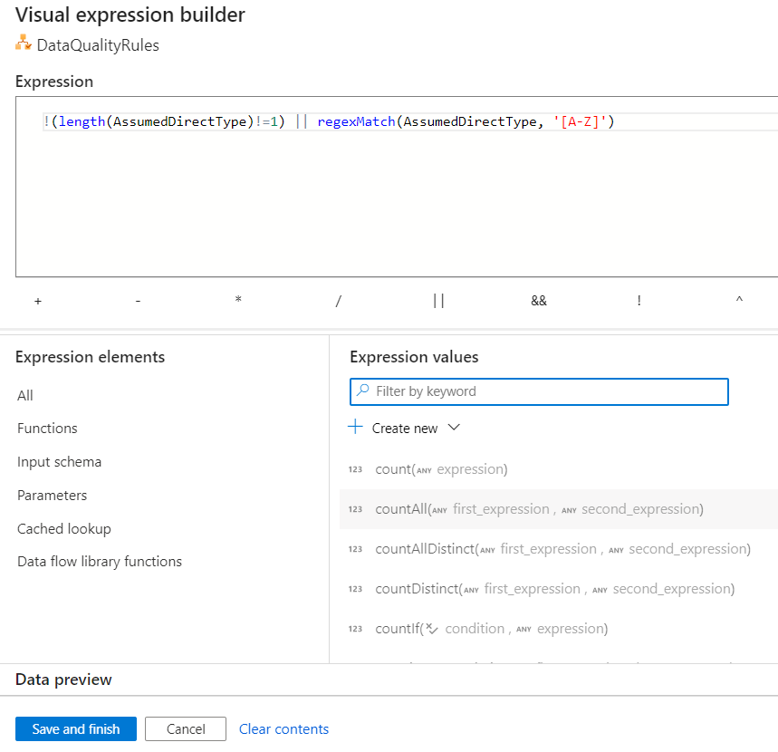
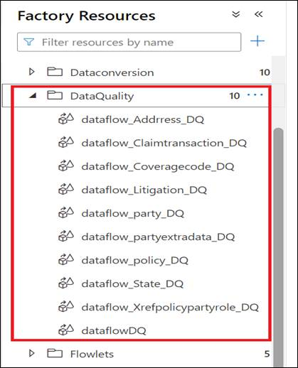
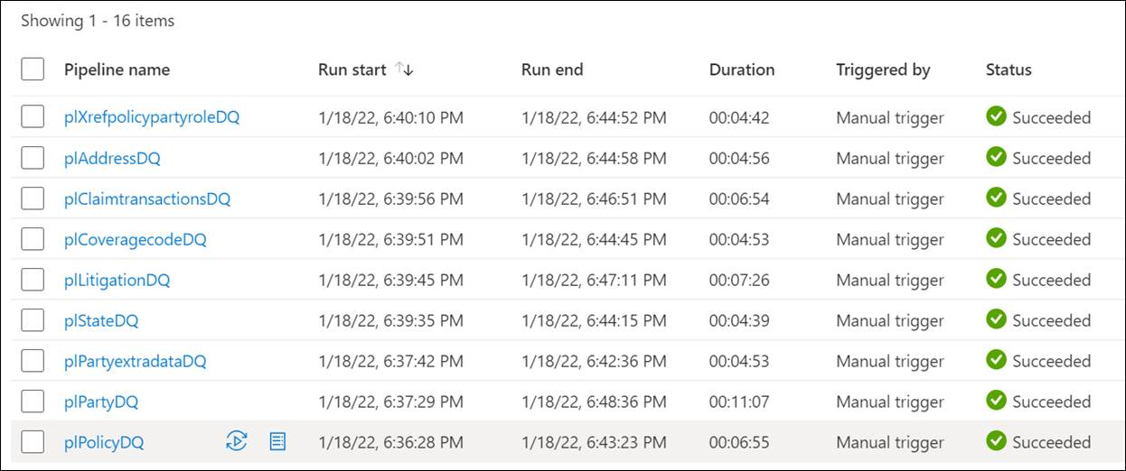
ADF Data Quality Rules – Visual Designer(Custom)
Enables you to build custom business rules quickly for data quality and data validation without writing any code logic.
Identify source data issues quickly and have client fix before Data Conversion activity.
Rich set of inbuilt functions available to quickly build complex rules.
Additionally, you can build rules that check for row uniqueness.
The assert transformation will help to determine if each row in your data meets a set of criteria. It also allows you to set custom error messages when data validation rules are not met
We have documented 100+ rich list of DQ rules and have implemented 30+ DQ rules ready for consumption.

Slide 32
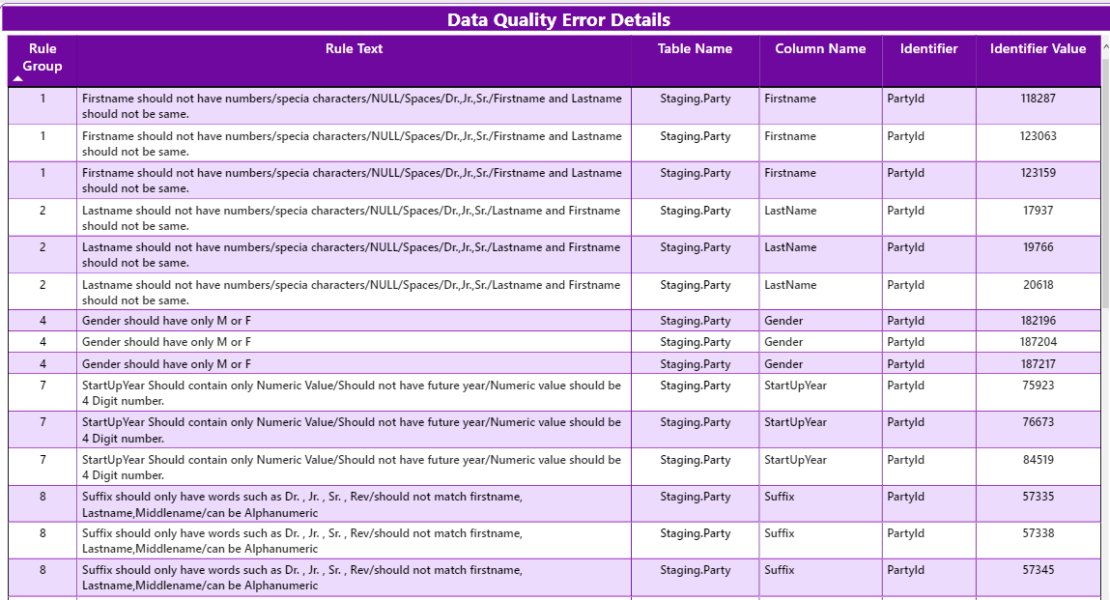
Custom Data Quality Rules – Reporting
Reports generated on top of records where Data Quality rules failed. Both summary & detailed view available
REPORT SUMMARY
DETAILED VIEW

Slide 33



ADF Framework – Metadata driven Flow
Using this framework, data/files can be copied from source server to target server with no code. Only metadata configuration is required. Steps like validation, transformation, conversion can also be configured to run in sequence/parallel
PIPELINE LEVEL CHANGES
Enable/Disable any steps as part of testing process
Add/remove new steps (Like validation, staging movement, transformation, etc.) Pipelines can be invoked dynamically based on the configuration.
Change the sequence of execution
TABLE LEVEL CHANGES
COLUMN LEVEL CHANGES
4. Change the sequence of execution
5. When new list of tables must be added/removed
6. Any pipelines that need to execute as part of this table flow (e.g., Data flows, Dependency logic)
7. When new list of columns must be added/removed
8. Specify Watermark column for Incremental Load
9. Enable/Disable any column name

Slide 34
Data Conversion – Transformation Options
1) ADF – Mapping Data Flow
2) Azure Databricks
3) Azure SQL/Synapse
Pros
Allow data engineers to develop data transformation logic without writing code
Azure Data Factory handles all the code translation, path optimization, and execution of your data flow jobs
Uses scaled-out Apache Spark clusters
Cons
Doesn't cater to high complexity transformations/business rules
Limited custom coding options
Versioning challenges
Pros
High complexity transformations are handled using Apache Spark clusters
Build with your choice of language, including Python, Scala, R and SQL
Delta Lake - Bring data reliability and scalability to your existing data lake
Cons
Need coding skills
Separate maintenance of Azure Databricks service
High costing compared to mapping data flow
Pros
Can handle high complexity transformations
Need SQL coding skills
Serverless query to perform transformation rules
Can be used as operational warehouse as well which can be a feeder for downstream applications
Cons
Need coding skills
Need to on-board all source data into SQL tables before transformation
Performance tuning is required for high volume of data

Slide 35


ADF Framework – Auditing, Custom Transformations
Auditing framework is re-usable for any new data conversion activities
AUDITING
Auditing captured on pipeline level
(Step Name, Pipeline name, start time, End time, Status, Run ID)
Auditing captured on table level (Source/Target schema, Source/Target tables)
Auditing captured on column level (Source/Target column names)
CUSTOM TRANSFORMATIONS
Any custom transformation/conversion logic which is implemented using SQL scripts/Stored procedures is taken care in this framework)

Slide 36
ADF Framework – Error Handling
Error Handling framework is re-usable for any new data conversion activities
ERROR HANDLING
Error captured on pipeline level (Error Message, Error time, Run ID)
Error captured on table level (Source/Target schema, Source/Target tables)
Error captured on column level (Source/Target column names)

Slide 37

Azure Monitor
Azure Monitor helps you maximize the availability and performance of your applications and services.
This information helps you understand how your applications are performing and proactively identify issues affecting them and the resources they depend on
Just a few examples of what you can do with Azure Monitor include:
Detect and diagnose issues across applications
Drill into your monitoring data for troubleshooting and deep diagnostics
Investigate change data for routine monitoring or for triaging incidents
SOURCE SQL , AZURE DATA LAKE, TARGET AZURE SQL
ADF, LOGIC APPS, AZURE MACHINE LEARNING

Slide 38




Azure Key Vault
Azure Key Vault is a cloud service for securely storing and accessing secrets. API keys, passwords, certificates, and cryptographic keys are examples of things you might want to keep private
This protects information from being revealed through source code or saved in local files, which is a common mistake made by many developers
Below screenshots shows the implementation of Key vaults in Source, Staging & Target servers used in ADF ETL implementation
SOURCE SERVER – SQL
STORAGE SERVER – AZURE DATA LAKE
TARGET SERVER – AZURE SQL

Slide 39



ADF Mapping Data Flow – Detailed Visual Logging
The Data Flow activity has a special monitoring experience where you can view total processed rows, processed time, stage time and data lineage information

Slide 40





ADF Flowlets - Data Flow Reusability
A flowlet is a reusable container of activities that can be created from an existing mapping data flow or started from scratch.
By reusing patterns, you can prevent logic duplication and apply the same logic across many mapping data flows
Below are some of the advantages
If there is a common ETL pattern, we can reuse it and prevent logic duplication and reduce developers build time
Flowlets can then be re-used inside other data flows
Can create logic to do things such as address cleaning or string trimming, date related transformations, etc.
Below is an example where a specific Transformation logic (Remove duplicates, Filter, Derived columns logic) is reused in multiple flows where source & target servers are different

Slide 41
Functional reconciliation
In the Data Conversion process, it is possible for mistakes to be made in the mapping and transformation logic. Issues like run time failures, network dropouts and broken transactions can corrupt data. This kind of errors can lead to data being left in an invalid state and incorrect information in reports
Functional reconciliation is a verification phase where the target data is compared against original source data to ensure that the data conversion architecture has transferred the data correctly
Below results are generated as part of existing functional reconciliation process:
Simple record counts check for each table to keep track of whether the targeted number of records have migrated or not
Compare SUM of measure fields between source and target
Compare individual transactions between source and target

Slide 42
Functional reconciliation – Report

Slide 43
Technical reconciliation – Logic Apps & ADF
Post data migration or data movement, an email summary with all auditing and error details are sent to the technical team automatically which gives a detailed picture on the below statistics
Percentage of Data Quality Failure, Data Quality Rejection Count
Percentage of Records Migrated Successfully, Records mismatch count
File Count, Row Count, Time Taken for each step and table
Status for each step and table (Success/Failure)
Start time & End time on each step and table
Error messages on each step, in case of any failures
Technical reconciliation components (Azure Data Factory, Azure Logic Apps) are re-usable for any new data migration/data conversion activities
Azure Logic Apps service is triggered post the data conversion/data migration. This service invokes SQL scripts and generates all reconciliation results and send those details in email summary. Detailed audit/logging information are sent in the email attachment

Slide 44

Technical reconciliation – Email summary DC to GW (Party)

Slide 45

Technical reconciliation – Email summary GW to DC (Policy , Coverage)

Slide 46
Technical reconciliation – Report

Slide 47

Trans codification Report

Slide 48

ADF Code Quality Checker
On every ADF development activity, considerable amount of time is spent on code review manually.
To reduce developer/lead’s time on code review, scripts are available which will scan and validate all ADF objects and provides the ADF Code Quality results in excel sheet. This makes sure that all team members are enforcing the naming conventions and best practices.
HIGH LEVEL STATISTICS
DETAILED INFORMATION

Slide 49

Automatic Documentation – ADF
Automation scripts will scan all ADF objects and generates them in excel format where we can use this as technical design document instead of manually preparing one and updating for each iteration/development changes.
This script scans the list of all data factories under azure subscriptions and get all ADF objects under them.
EXCEL OUPUT
DETAILS AVAILABLE IN EXCEL SHEET

Slide 50
Data Conversion – Estimation Tool
Estimating Tool
A data conversion estimator tool can provide several benefits in the context of a data conversion project.
Here are some of the key advantages:
Accurate Time and Effort Estimation: Provides predefined criteria and parameters to calculate the time and effort required for data conversion tasks. By considering various factors such as schemas, complexity, and transformation requirements, the tool can provide more accurate estimates compared to manual estimation methods. This helps in better project planning and resource allocation.
Project Planning and Scheduling: With accurate estimates provided by the estimator tool, project managers can create realistic project plans and schedules.
Comparison and Evaluation: By adjusting input parameters & criteria’s, project managers can assess the impact of changes. This aids in decision-making and selecting the most efficient and cost-effective approach

Slide 51
Reusable Components
S.No | Topic | ReUsability (Yes/No) | Features | Comments
1 | Mapping Automation | Yes | 1) Auto generate source & target schema profiling results 2) Auto generate source data profiling results 3) Auto Generate ER diagram 4) Auto Generate mapping template For Target Tables 5) Auto Generate Cross Reference Comparison results (Source & Target) 6) Status Dropdown & Formulas for All Source Table Fields | 1) Currently tested for SQL server, can be enhanced to other databases (e.g. Oracle, IBM DB2 with minor configuration changes)
2 | Extract (Data Copy) | Yes | 1) 1:1 data movement is covered as part of Metadata driven framework 2) Table/column level changes are configurable 3) Custom filters/conditions for each table are configurable 5) Enable/Disable any steps as part of testing process | 1) Provides OOTB support for 50+ connectors
3 | Transformation Logic | No | 1) Azure Mapping data flow Visual designer (no code) 2) Azure Databricks/Azure functions for high complexity transformations and huge data volume 3) Azure SQL/Synapse for SQL coding skills and handle high complex transformations | Custom development is required for now.
4 | Data Quality Rules | Yes (Basic) | Configuration driven. 13 generic rules are covered here (BA configures the rules in excel and run the DQ pipelines) | Azure functions framework built for basic Data Quality. For complex DQ rules, use Azure Databricks/Azure Functions
5 | Data Quality Rules | No (Advanced) | For high complexity transformations and business rules/validations | Azure Databricks/Azure functions/Azure SQL
6 | Data Quality Reports | Yes | Reports generated on top of records where Data Quality rules failed. Both summary & detailed view available | Power BI dashboards
7 | Auditing | Yes | 1) Auditing captured on pipeline level (Step Name, Pipeline name, start time, End time, Status, Run ID) 2) Auditing captured on table level (Source/Target schema, Source/Target tables) 3) Auditing captured on column level (Source/Target column names) | Azure SQL framework
8 | Error Handling | Yes | 1) Error captured on pipeline level (Error Message, Error time, Run ID 2) Error captured on table level (Source/Target schema, Source/Target tables) 3) Error captured on column level (Source/Target column names) | Azure SQL framework
9 | Restart Mechanism | Yes | Restart from the point of failure | Azure SQL framework
10 | Technical Reconciliation - Framework | Yes | 1) Percentage of Data Quality Failure, Data Quality Rejection Count 2) Percentage of Records Migrated Successfully, Records mismatch count 3) File Count, Row Count, Time Taken for each step and table 4) Status for each step and table (Success/Failure) 5) Start time & End time on each step and table 6) Error messages on each step, in case of any failures | Azure SQL, Logic Apps
11 | Technical Reconciliation - Reports | Yes | Same as above | Power BI reports available as part of framework. Specific Changes based on client requirements will be done by Client
12 | Functional Reconcialition - Framework | Yes (Partial) | 1) Partially resusable (Record counts check for source & target tables, SUM of measure fields between source and target) 2) Needs custom build(Compare individual transactions/field values between source and target) | Azure Data Factory components
13 | Functional Reconcialition - Reports | Yes (Partial) | Same as above | Power BI reports available as part of framework. Specific Changes based on client requirements will be done by Client
14 | ADF code quality checker | Yes | Scan and validate all ADF objects and provides the ADF Code Quality results in excel sheet
15 | ADF automatic documentation | Yes | Automation scripts will scan all ADF objects and generates them in excel format

